Slide 1
Home Improvement
By: Anthony Lathrop

Slide 2
EDA, Cleaning and Initial Visualizations
Columns with excessive null values were dropped from the data set
Other null values were imputed with appropriate values based on variable type
Boxplots were created for each numeric variable to visualize outliers; Outliers were determined not to have a significant effect on model quality due to small quantity
Correlations were visualized via heatmap:

Slide 3
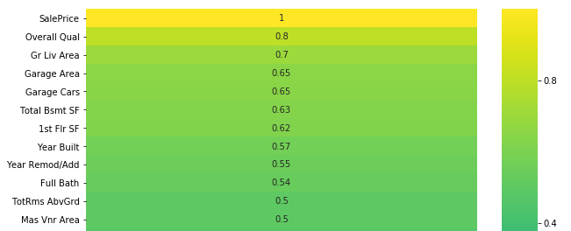

Slide 4

Initial Model Creation
Motivation: Build model based on highest correlation to sale price
Build features matrix based on these highly correlated factors
The result were metric values:

Slide 5

Model Tuning
Categorical variables were factored into the model based upon their impact to one’s first impression of a home
Emotional home-buying decisions are common in the real-estate market so positive correlations were identified with categorical variables:
Neighborhood, building type, house style, exterior quality, exterior condition, kitchen quality, garage quality, garage condition, and presence of a paved driveway were added to the model
Adding these features into the model resulted is the following metric values:

